Slide 1
Supervised Learning
Chapter 05 – Laura lgual & Santa Segui

Slide 2
Machine Learning
Three types of machine learning
Supervised learning: Learns by use of labeled data. Example Spam prediction algorithm
Classification
Multiclass classification
Binary classification
Regression
Unsupervised learning: Learns by use of unlabeled data. Ex Cluster books based on category
Clustering (Connectivity, Centroid, Statistical)
Outlier detection
Latent variable modeling
Reinforcement learning: Software agents take actions in an environment and automatically try to improve its behavior. System of reward and punishment. Games
Q-Learning
Deep Q-Learning

Slide 3
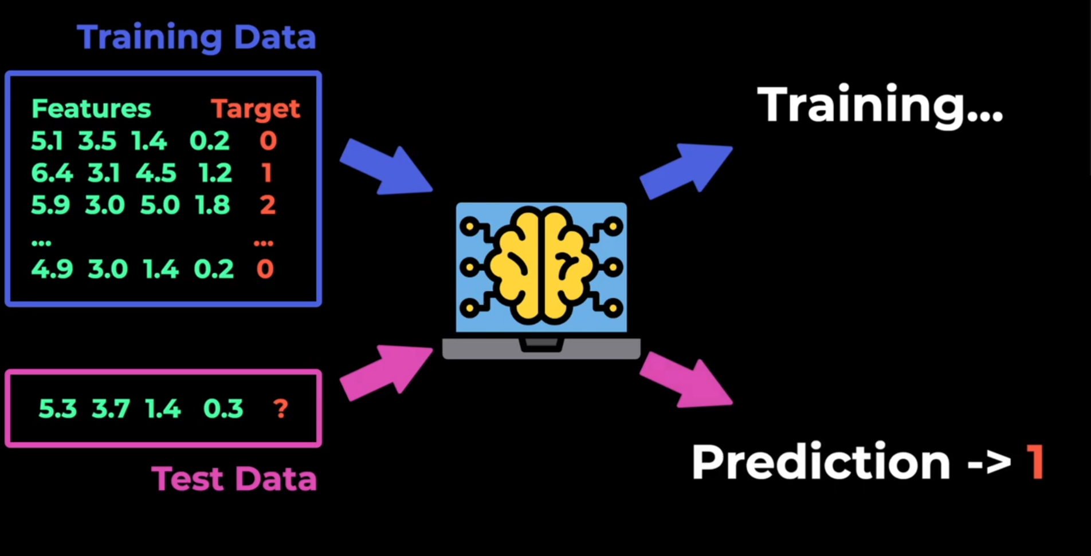
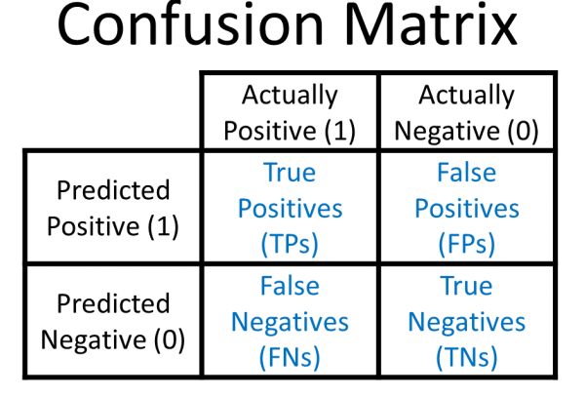
Classification algorithm – Confusion matrix
A table is used to measure the performance of a classification algorithm.

Slide 4

Classification algorithm – Confusion matrix
Several performance metrics are defined through the combination of these elements.
Accuracy: Accuracy measures the overall correctness of a classification model. It is the ratio of correctly predicted observations to the total observations.
Accuracy is useful when dataset is balanced (i.e. the number of positive and negative samples are similar).
However, in imbalanced datasets (e.g. rare case detection, such as rare disease, or fraudulent transaction etc) accuracy can be misleading, because model might predict the majority class well, while failing in the minority class.
High accuracy is useful for balanced datasets.

Slide 5

Classification algorithm – Confusion matrix
Sensitivity: [Also called recall or True Positive Rate] Sensitivity measures the model’s ability to correctly identify positive cases (e.g. detecting a disease when it is actually present)
Sensitivity is important in scenarios where missing a positive case is costly such as cancer detection.
A high recall ensures that most positive cases are identified
Even if some false positive occurs.

Slide 6

Classification algorithm – Confusion matrix
Specificity: [Also called True Negative Rate] Specificity measures the model’s ability to correctly identify negative cases (e.g. correctly identifying healthy individuals as not having a disease)
Specificity is important in cases where false positive need to be minimized.
Such as spam detection (avoiding classifier throwing legitimate emails in spam)

Slide 7

Classification algorithm – Confusion matrix
Precision: [Also called Positive Prediction value] Precision measures how many of the predicted positive cases are actually positive. It focuses on the correctness of positive predictions.
Precision is essential in scenarios where false positive can have severe consequences, such as in fraud detection or judicial decisions (e.g. wrongful conviction)

Slide 8

Classification algorithm – Confusion matrix
Negative Prediction Value (NPV): It measures how many of the predicted negative cases are actually negative.
It is important when ensuring negative predictions are reliable.
E.g. ruling out diseases in medical test.

Slide 9
Classification algorithm – Confusion matrix
Accuracy: Accuracy measures the overall correctness of a classification model. It is the ratio of correctly predicted observations to the total observations.
Sensitivity: [Also called recall or True Positive Rate] Sensitivity measures the model’s ability to correctly identify positive cases (e.g. detecting a disease when it is actually present)
Specificity: [Also called True Negative Rate] Specificity measures the model’s ability to correctly identify negative cases (e.g. correctly identifying healthy individuals as not having a disease)
Precision: [Also called Positive Prediction value] Precision measures how many of the predicted positive cases are actually positive. It focuses on the correctness of positive predictions.
Negative Prediction Value (NPV): It measures how many of the predicted negative cases are actually negative.

Slide 10
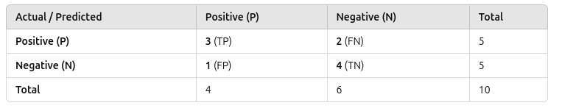
Classification algorithm – Confusion matrix - Example
0.7
0.6
0.8
0.75
0.67

Slide 11

Classification algorithm – Confusion matrix
Precision – Recall Tradeoff :
If you increase Precision (PPV), Recall (Sensitivity) might decrease, and vice versa.
Example: In fraud detection, increasing precision ensures only real fraud cases are flagged, but some fraud cases may go undetected (lower recall).
F1 Score
When you need a balance between Precision and recall, use F1 score
F1 score is useful when both false positives and false negatives are equally important

Slide 12
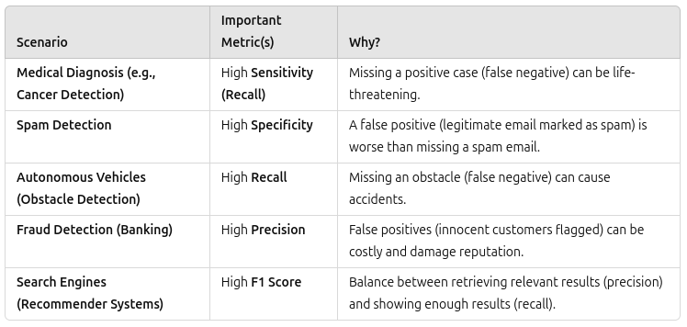
Classification algorithm – Choose right metrics

